Slide 1

CNN-Based Music Instrument Recognition System
Leveraging deep learning to automatically identify instruments in music tracks for enhanced audio analysis and music production workflows.

Slide 2
Table of Contents :
1. The Challenge of Instrument Identification
2. Core Project Objectives
3. Expected Outcomes & Applications
4. Technology Stack
5. System Architecture Overview
6. Audio Preprocessing Pipeline
7. User Interface Design
8. Key Application Domains
9. Conclusion & Future Directions

Slide 3

The Challenge of Instrument Identification
Identifying instruments within music tracks is fundamental to numerous applications including audio tagging, intelligent remixing, music library indexing, and sophisticated recommendation systems.
Manual instrument labelling remains time-consuming, labour-intensive, and prone to human error—particularly when analysing complex polyphonic recordings with overlapping timbres.
InstruNet AI addresses this challenge by automatically detecting instruments in music tracks using Convolutional Neural Networks applied to audio spectrograms, dramatically reducing analysis time whilst improving accuracy.

Slide 4
Core Project Objectives
01
02
03
Audio-to-Image Conversion
CNN Training & Classification
Multi-Instrument Detection
Transform audio tracks into spectrogram representations using mel-spectrogram or STFT techniques for visual pattern recognition.
Develop and train a convolutional neural network to accurately classify individual instruments from spectral features.
Enable simultaneous detection of multiple instruments within complex, polyphonic musical arrangements.
04
05
Intuitive Output Generation
Comprehensive Reporting
Provide user-friendly visualisations showing instrument presence, confidence levels, and intensity patterns throughout tracks.
Generate detailed analytical reports in JSON and PDF formats for integration into production pipelines and research workflows.

Slide 5
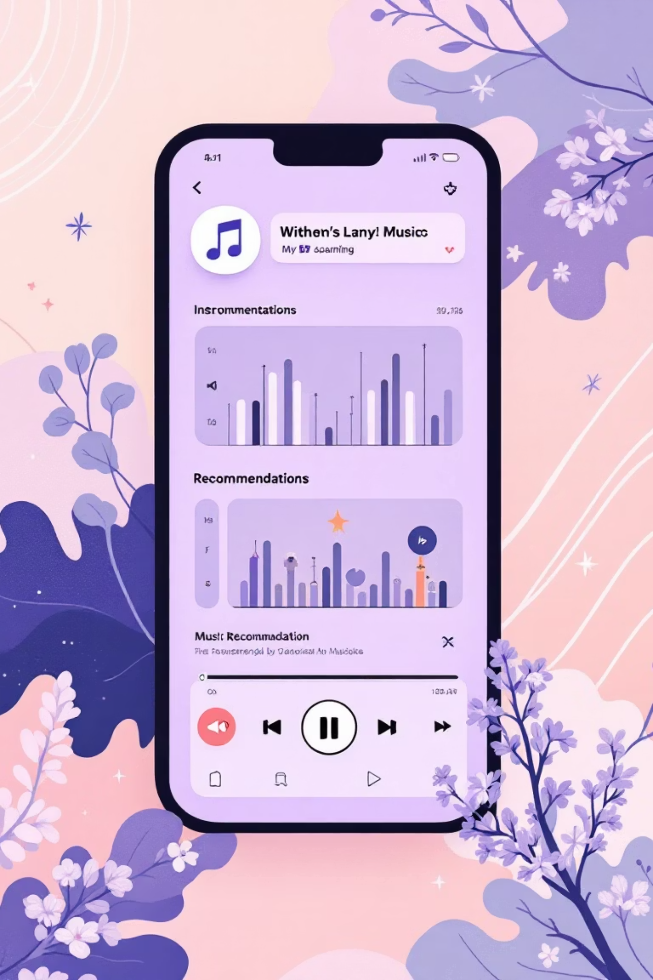
Expected Outcomes & Applications
Automatic Detection
Real-time identification of instruments in music tracks without manual intervention, dramatically accelerating audio analysis workflows.
Multi-Label Classification
Simultaneous recognition of piano, guitar, drums, violin, bass, brass, strings, and other instruments within complex arrangements.
Temporal Visualisation
Dynamic representations of instrument presence and intensity patterns across the temporal structure of tracks.
Industry Applications
Enhanced music recommendation engines, intelligent audio tagging systems, stem-based remixing tools, and music education platforms.

Slide 6







Technology Stack
Core Language
Python 3 for rapid development and extensive ML library support
Audio Processing
Librosa for feature extraction, PyDub for audio manipulation
Deep Learning
TensorFlow/Keras or PyTorch for CNN architecture and training
Visualisation
Matplotlib and Seaborn for spectrogram and results visualisation
Training Data
Kaggle Dataset or custom labelled music corpora
Interface (Optional)
Streamlit or Dash for interactive web-based demonstration

Slide 7





System Architecture Overview
Audio Input Module
Accepts uploaded or recorded files in WAV/MP3 formats
Preprocessing Unit
Converts audio into mel-spectrograms or MFCC representations
CNN Architecture
Performs multi-label classification with probability outputs
Post-Processing
Aggregates temporal predictions for final instrument labels
Output Module
Visualises results and exports analytical reports
The VANIDYA AI pipeline seamlessly integrates audio processing, deep learning inference, and visualisation to deliver comprehensive instrument recognition capabilities suitable for both research and production environments.

Slide 8
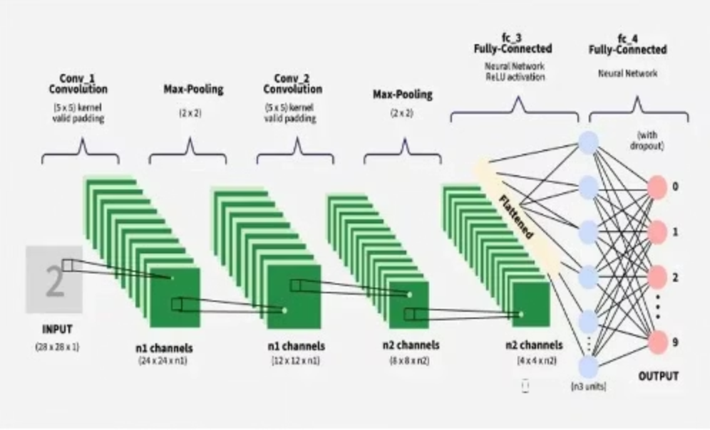
CNN Architecture
This architecture is designed to efficiently process spectral features extracted from audio, learning intricate patterns to distinguish between various musical instruments even in complex arrangements.

Slide 9
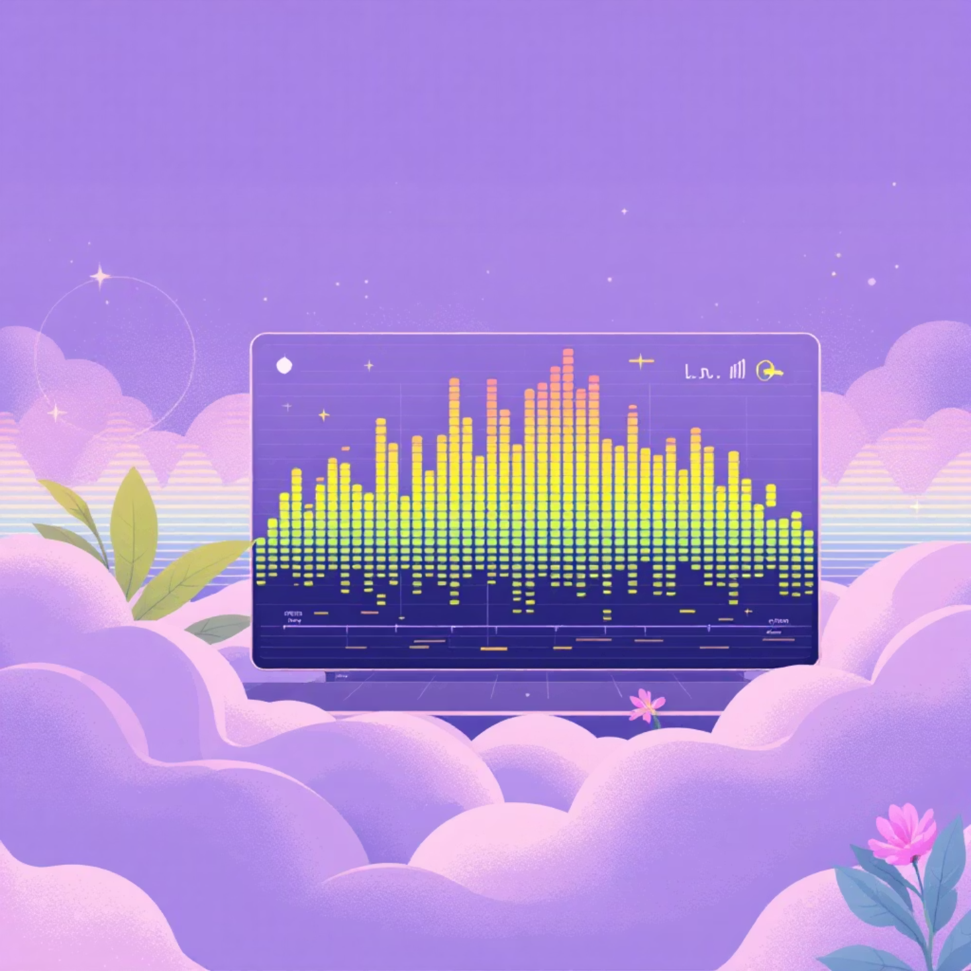
Audio Preprocessing Pipeline
Spectrogram Transformation
Raw audio waveforms are converted into visual representations that capture frequency content over time, enabling the CNN to recognise characteristic spectral patterns unique to each instrument.
Mel-Spectrogram: Perceptually-scaled frequency representation mimicking human auditory perception
STFT: Short-Time Fourier Transform for detailed frequency-time resolution
MFCC: Mel-Frequency Cepstral Coefficients for compact timbral feature extraction
Time-windowed segmentation allows the model to analyse temporal evolution of instrument presence throughout the track duration.

Slide 10





User Interface Design
Audio Upload
Real-Time Visualisation
Instrument Predictions
Drag-and-drop or browse to upload tracks, with support for direct recording through the web interface for immediate analysis.
Interactive waveform and spectrogram displays providing immediate visual feedback on uploaded audio content structure.
Clear display of detected instruments with confidence percentages, visual probability bars, and colour-coded certainty indicators.
Temporal Analysis
Report Export
Timeline graphs illustrating which instruments are active during specific time segments throughout the track's duration.
Download comprehensive JSON or PDF reports containing detailed analysis summaries suitable for archival or further processing.

Slide 11
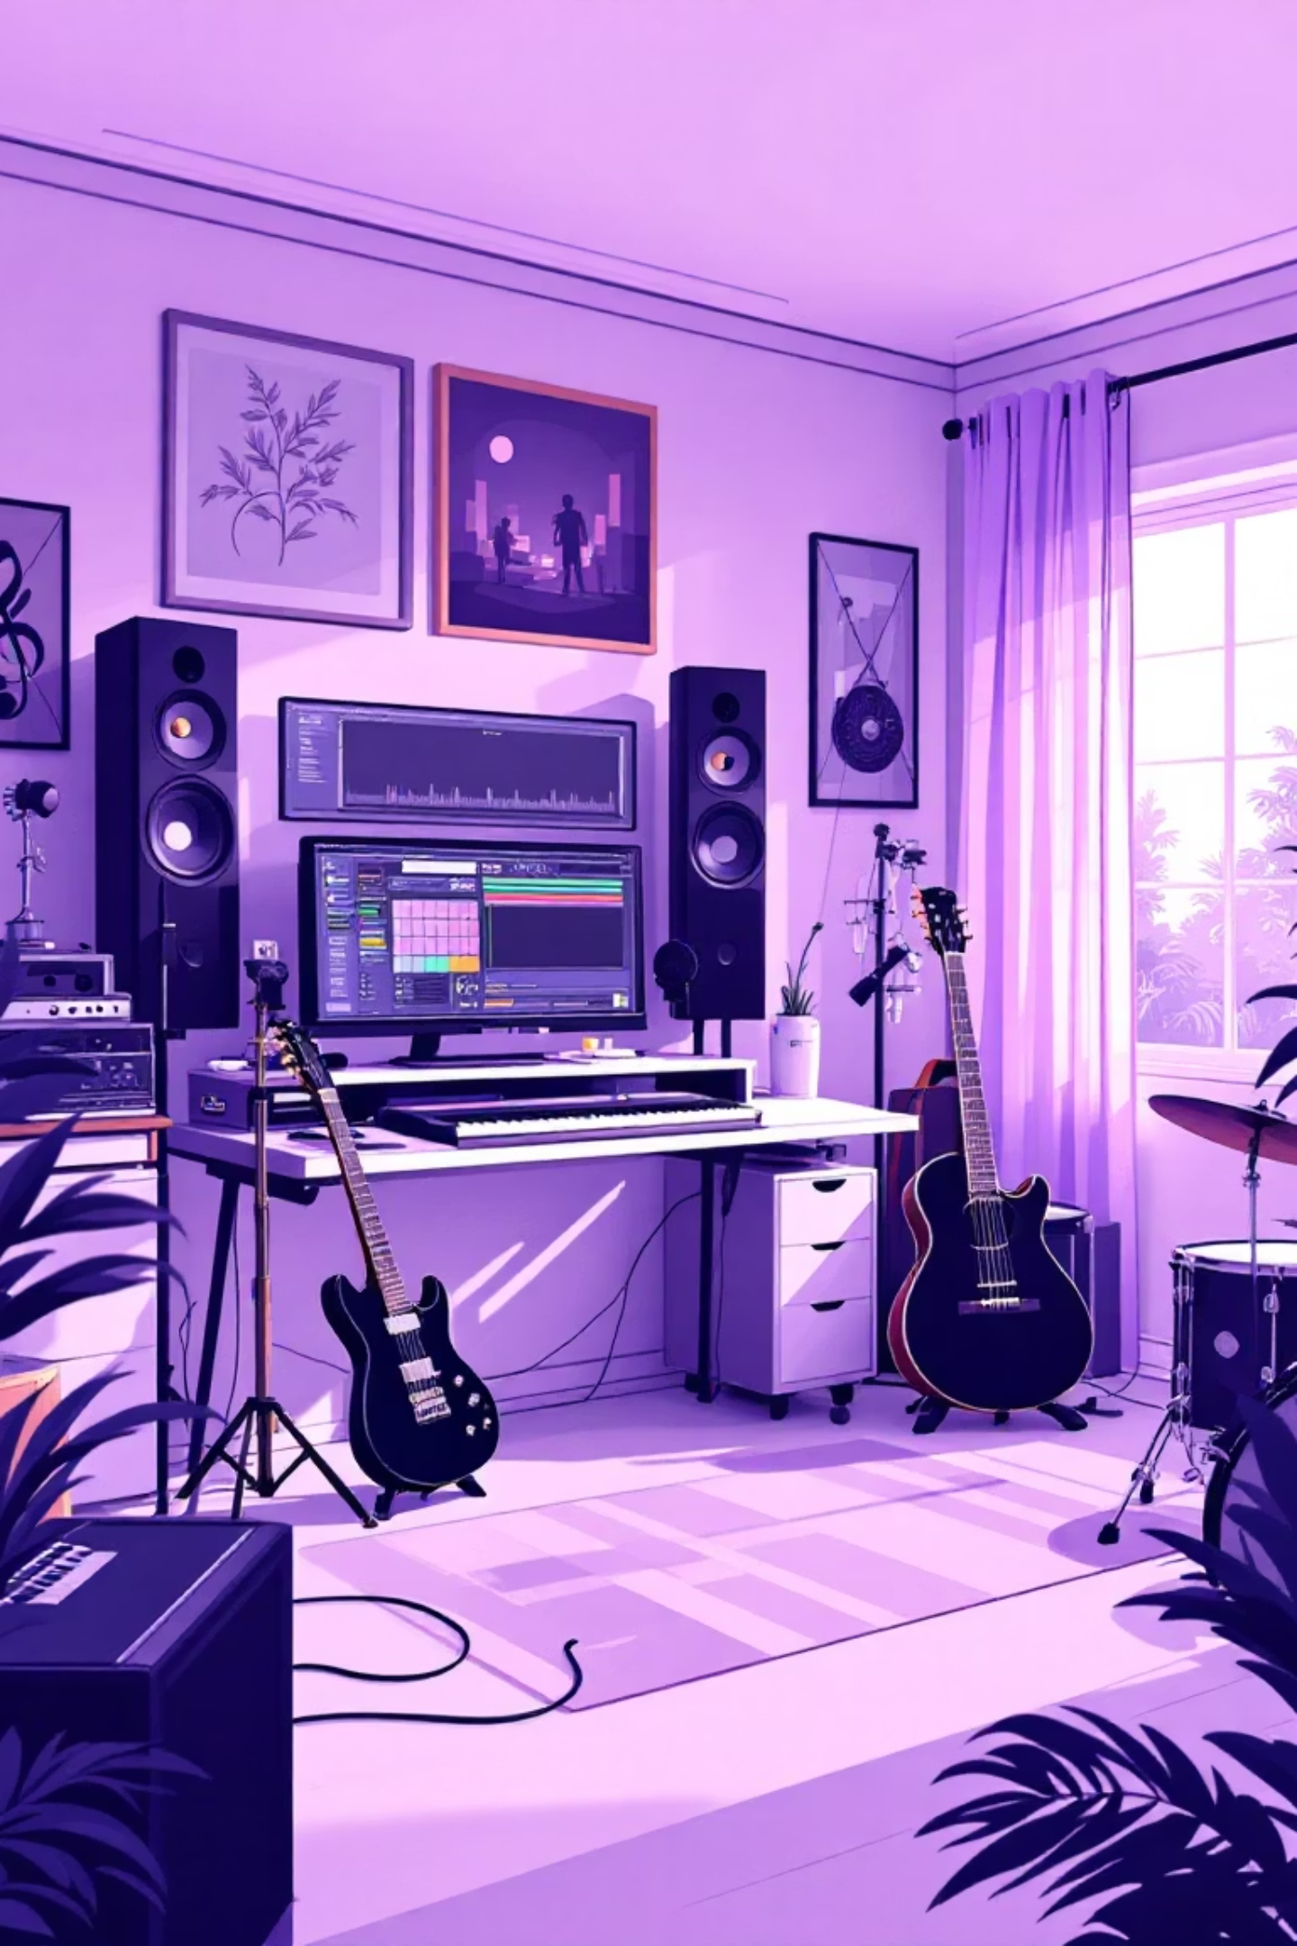




Key Application Domains
Music Recommendation
Enhance discovery engines by enabling instrument-based filtering, similarity matching, and personalised playlist generation based on instrumentation preferences.
Automated Tagging
Streamline music library organisation with automatic metadata enrichment, reducing manual cataloguing effort whilst improving searchability.
Intelligent Remixing
Enable stem-aware audio manipulation, instrument isolation for creative production, and automated track decomposition for DJ tools.
Music Education
Support ear training applications, instrument recognition tutorials, and analytical tools for music theory students and educators.

Slide 12

Conclusion & Future Directions
Project Impact
Future Enhancements
VANIDYA AI demonstrates the powerful application of deep learning to music information retrieval, offering a robust solution for automatic instrument recognition that significantly reduces manual effort while improving accuracy.
Extend recognition to 100+ instruments including ethnic and rare instruments
Real-time processing for live performance analysis
Source separation capabilities for stem extraction
By combining sophisticated CNN architectures with intuitive visualisation tools, the system bridges the gap between cutting-edge machine learning research and practical music industry applications.
Integration with digital audio workstations
Mobile application deployment for on-the-go analysis

